Slide 1
Experimental Procedure
Materials:
Nappies (4 different brands)
Water
Food Dye
Canola Oil
Graduated Cylinder
Watch Glass
Scissors
Method:
Take one nappy, cut into a small square (approx. 4cm) and place onto a watch glass.
In 20 mL lots, add water to the nappy and observe the absorption. Continue to add water until nappy does not absorb any more.
Repeat steps 1 and 2 with oil, and an oil/water (1:1) mixture.
If you have time: repeat method with other types of nappies to compare absorption between brands.

Slide 2
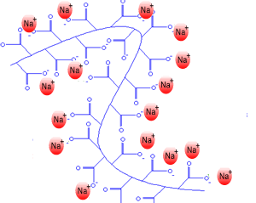
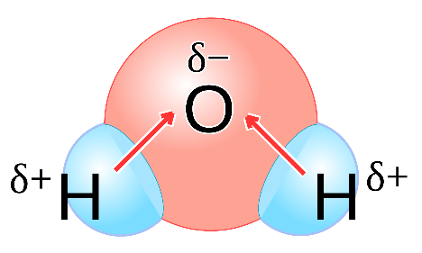
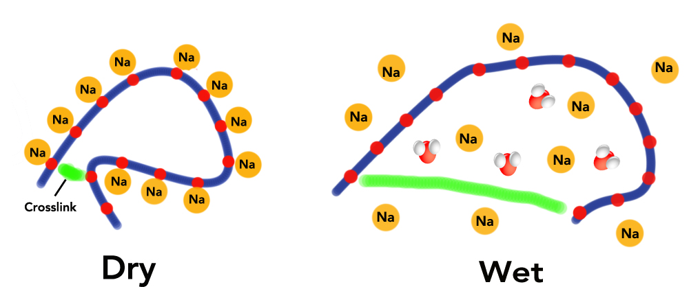
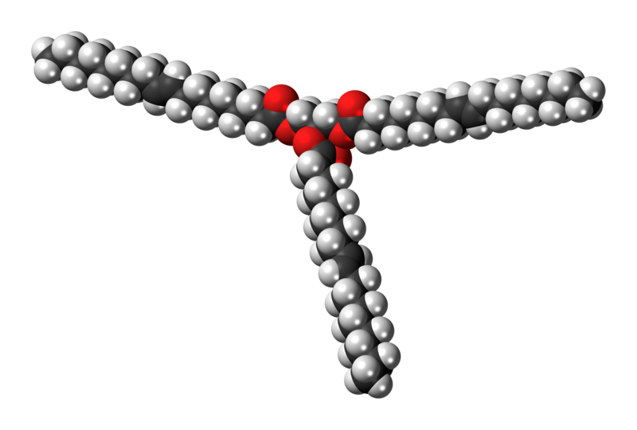
Chemical Explanation
What’s going on? From a chemical perspective, we need to consider the physical and chemical structure of the water and oil, and of the nappy fibres (sodium polyacrylate).
How? When water is added, the negative portions of the nappy fibre are attracted to the positive end of the water molecules. As more and more water molecules are attracted, the long molecule stretches and straightens. This exposes even more areas that are attracted to water.
Also, the polarity of the liquid tells us about the interaction it has with the nappy.
Sodium Polyacrylate
Water
Oil
https://www.acs.org/content/acs/en/education/whatischemistry/adventures-in-chemistry/experiments/diapers.html

Slide 3
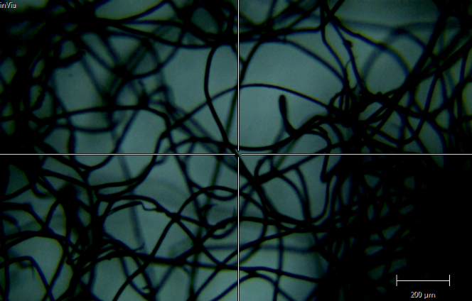
Chemical Explanation
What’s going on? From a chemical perspective, we need to consider the physical and chemical structure of the water and oil, and of the nappy fibres (sodium polyacrylate).
How? When water is added, the negative portions of the nappy fibre are attracted to the positive end of the water molecules. As more and more water molecules are attracted, the long molecule stretches and straightens. This exposes even more areas that are attracted to water.
Also, the polarity of the liquid tells us about the interaction it has with the nappy.
Sodium Polyacrylate
Water
Oil
https://www.acs.org/content/acs/en/education/whatischemistry/adventures-in-chemistry/experiments/diapers.html

Slide 4
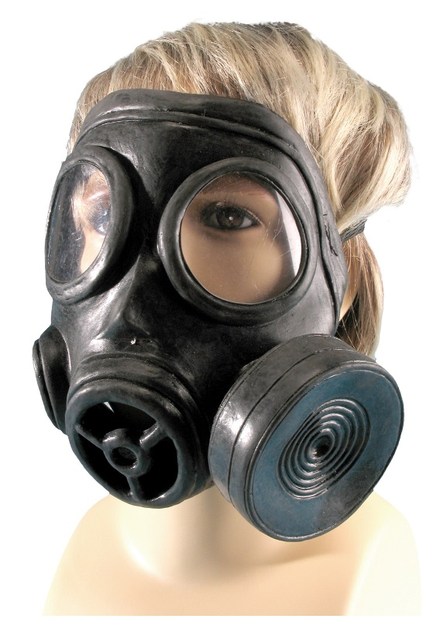
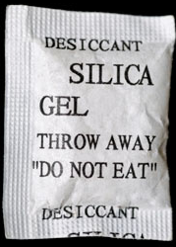
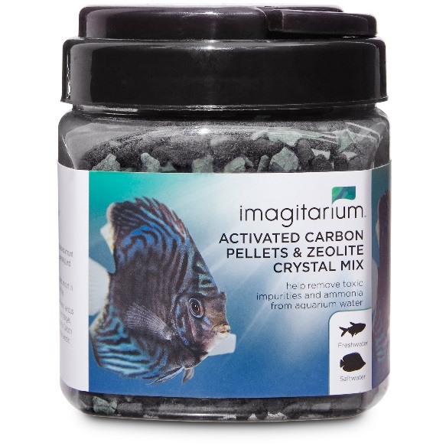
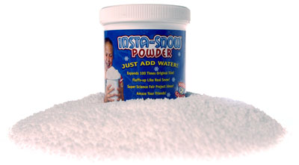
Real Life Application of Absorbents
Silica gel desiccants
Industrial spill kits
Gas masks
Activated charcoal
Techni ice
Fake snow

