Slide 1
Introduction
Photocatalytic Degradation of Commercial Food Dyes by Titanium Dioxide (TiO₂)
O₂
Degradation mechanism of dyes
Bleaching of dyes has been carried out by a photo-oxidation process. Indeed, the irradiation of solid semiconductors (TiO₂) by light of suitable energy leads to electron excitation generating electron–hole pairs that can react with water and dissolved oxygen to form various oxidizing species such as hydroxyl radicals. These highly reactive species are able to oxidise organic molecules such as dyes.
Advantages of this process:
Effective for decolorization of dyes
2. Inexpensive materials and equipment
3. Non-toxic TiO₂
CO₂ & H₂O
O₂·
Dye
TiO₂
OH ·
e⁻
h⁺
H₂O

Slide 2
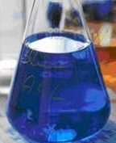
Experimental Procedure
Materials and equipment
Red (Ponceau 4R) and Blue (Brilliant Blue FCF) food dyes
Titanium dioxide powder (Degussa P-25)
Commercial UV lamps (48 W, operating wavelength: 365 – 405 nm)
2 volume flask (500 mL)
4 glass petri dishes
4 weight boats
Experimental Method
NO. | Dye | TiO₂ (Degussa P-25) | UV light
1 | ✓ (Red) | ✓ | ✓
2 | ✓ (Blue) | ✓ | ✓
3 | ✓ (Blue) |  | ✓
4 | ✓ (Blue) | ✓
Experimental Method
The red and blue solutions will be prepared in 2 different volume flasks.
For each demonstration, the dye solution will be diluted to the desirable final concentration.
Beaker #1 will present a solution of red food dye and Degussa P-25 which will be exposed to UV light. Beaker #2 will present a solution of blue food dye and Degussa P-25 which will be exposed to UV light. Finally, Beaker #3 and #4 will consist of the control solutions for both dyes with no Degussa P-25 added which will be placed under a UV lamp.
4. After10 minutes of being exposed, the results for the 4 beakers can be compared.

Slide 3
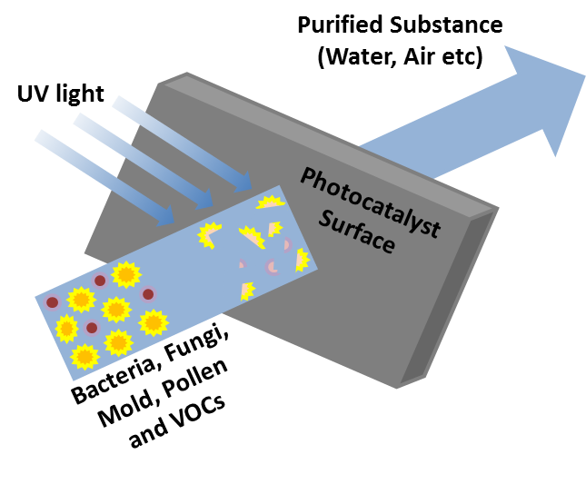
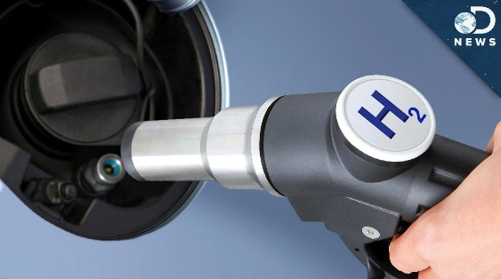
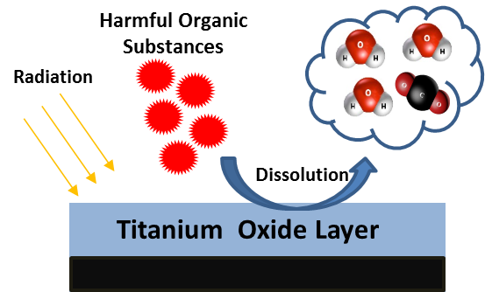
Other applications of photocatalysts
Air & Water purification
Hydrogen generation
Sterilization & Self cleaning surface

Slide 4
Mechanism of photocatalytic degradation of dyes
By irradiation of aqueous TiO₂ suspension with light energy greater than its band gap energy (Eg, 3.2 eV), conduction band electrons (e⁻) and valence band holes (h⁺) will be generated. The photogenerated electrons could reduce the dye or react with electron acceptors such as O₂ adsorbed on the Ti-surface or dissolved in water, reducing it to superoxide radical anion O₂^{•−}. The photogenerated holes can oxidize the organic molecule to form R⁺, or react with OH⁻ or H₂O oxidizing them into OH• radicals. Together with other highly oxidant species (peroxide radicals), they are responsible for the heterogeneous TiO₂ photodecomposition of organic substrates as dyes. According to this, the relevant reactions at the semiconductor surface leading to the degradation of dyes can be expressed as follows: .
TiO₂ + hv(UV) → TiO₂ (e_{CB} ⁻ + h_{VB}⁺) (1)
TiO₂(h_{VB} ⁺) + H₂O → TiO₂ + H⁺ + OH• (2)
TiO₂(h_{VB}⁺) + OH⁻ → TiO₂ + OH• (3)
TiO₂(e_{CB}⁻) + O₂ → TiO₂ + O₂^{•−} (4)
O₂^{•−} + H⁺ → HO₂• (5)
Dye + OH• → degradation products (6)
Dye + h_{VB}⁺ → oxidation products (7)
Dye + e_{CB}⁻ → reduction products (8)
Konstantinou IK, Albanis TA. TiO₂-assisted photocatalytic degradation of azo dyes in aqueous solution: kinetic and mechanistic investigations: a review. Applied Catalysis B: Environmental. 2004;49(1):1-14.

