Slide 1
Experimental Procedure
Materials
300 mL suspension
Sieves
Bucket
Waste water drum
Cleaning wipes
Method
Stack sieves according to size (finest mesh on the bottom)
Pour suspension through the sieves. Wait 3 minutes for the water to pass through.
Observe how at each step, particles larger than the sieve hole gets left behind thus separating the individual components of the mixture.
Compare the water before and after filtration. Which one is more clear? What colour sand has the largest particles?
Pour waste into waste drum and wipe sieves clean.

Slide 2
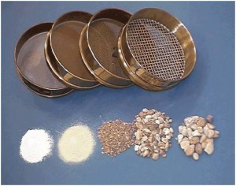
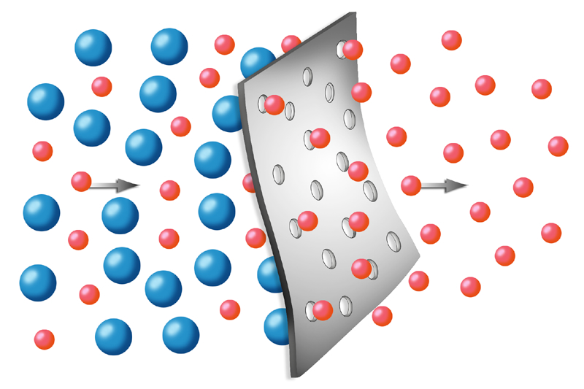
Chemical Explanation
Chemical explanation
What?
We use sieves of different sized holes to separate a mixture of solids and a liquid. We can separate substances using this method.
How?
The hole size of the sieve determines which particle passes through and which particles are retained.
When the sieve has a hole of a certain dimension, only particles of that dimension or smaller would pass through. This leaves the larger particles in the sieve.

Slide 3
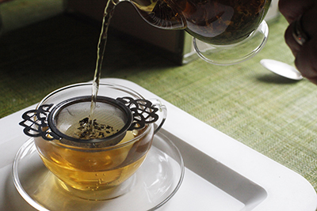
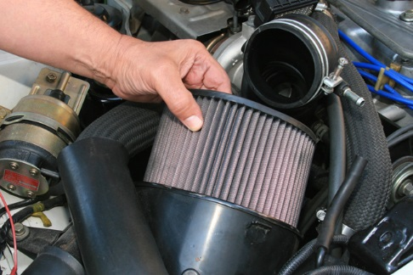
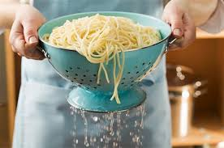
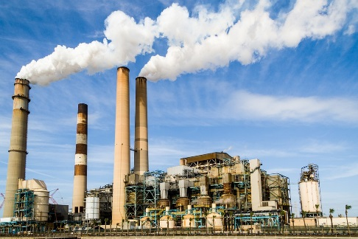
Real Life Applications
Day-to-day uses
Industrial uses
Separating tea leaves from tea using sieve
Air filter in car to stop dust entering engine
Separating spaghetti from water using sieve
Gas processing plants use membrane filters to stop CO₂

